Slide 1
CoHUB
Cross-platform Bookmark Management App
Chen Sun
Notes:
Good afternoon everyone today we'd like to introduce our capstone project ,a mobile application named cohub.

Slide 2

1
Introduction
Functional Design
Application Development
Algorithm Implementation
Conclusion and Proepects
2
CONTENT
3
4
5
1
Notes:
We will present our project from these 4 aspects

Slide 3
1 Introduction
Notes:
Before i introduce cohub, please allow me to share the research background of it.

Slide 4


BACKGROUND
Information Overload
Diversification of information source
Inefficiency of existing information management systems
3
Notes:
As We all know, the digital age has hit us with an large amount of content and information. Traditional content management systems (CMS) are struggling to keep up with this flood.so we intro ai-techniches into CMS. However, it's not all smooth sailing. AI-powered CMS face a couple of big challenges. First, training AI with billions of pieces of information is super expensive. Second, when AI labeling systems are designed for just one platform, they can struggle with quality and usability if the content comes from different sources.

Slide 5

SUBSECETION TITLE
CoHub:
A content management mobile application help to manage content online through cross-platform CMS framework and transformer-based techniques.
Figure: The logo of Cohub
4
Notes:
That's why we're going to build CoHub, a fantastic content management mobile application. CoHub helps user manage their content online using a cross-platform CMS framework .
With CoHub, you can easily organize and handle your content across different platforms, making your workflow more efficient and effective.

Slide 6


COMPETITORS
Pocket
Pocket is an app for saving articles and videos to read or watch later, offering a distraction-free reading experience.
Advantages: Simple interface for saving articles and videos.
Disadvantages: Limited cross-platform support and link parsing functionality.
Evernote Evernote is a versatile note-taking and task management app that enhances productivity across devices.
Advantages: Powerful document management and editing functions.
Disadvantages: Weaker link parsing functionality and compatibility issues.
5
Notes:
To better understand cohub's goals, I'll briefly introduce two main competitors of our app, Pocket and Evernote.
Pocket is an app designed for saving articles and videos to read or watch later. It has simple interface ,but it has limited cross-platform support .
Evernote is a versatile app for note-taking and task management, it is powerful in editing document, but it is weaker in link parsing.
These insights highlight where Cohub stands out and where we can continue to improve.

Slide 7
COMPETITORS
Robust Features
Cross-Platform Consistency
Performance Optimization
Limited Advanced Features
Market Recognition
Resource Intensive
S
W
Cohub
User Feedback Implementation
AI Integration
Market Expansion
Emerging Technologies
O
T
Intense Competition
Rapid Technology Changes
Rising User Expectations
Privacy and Security
6
Notes:
so above all we can get this SWOT analysis of cuhub.
first Strengths: Cohub offer robust features like folder management, link parsing, and tagging. Our product ensures seamless performance across iOS and Android, and we've optimized user paths for efficiency.
However, there are Weaknesses: We lack advanced integrations with tools like WeChat and XMind。
at the same time, Opportunities include improve cohub by addding some integrating AI for smarter categorization and personalized recommendations.
But we face Threats: Intense competition from Pocket and Evernote, rapid technology changes requiring constant innovation, rising user expectations, and challenges in ensuring data privacy and security.
——————————————————————————————————————————————————————————————
Strengths
Robust Features: Core functionalities like folder management, link parsing, and tagging.
Cross-Platform Consistency: Seamless performance on iOS, Android.
Performance Optimization: Efficient user paths and quick link parsing.
Weakness
Limited Advanced Features: Lacks some Integration features with productivity tools,like wechat,notebook,xmind ect. Market Recognition: Lower brand awareness compared to Pocket and Evernote.
Resource Intensive: Future development and AI integration require significant resources.
Opportunities
User Feedback Implementation: Enhance search filters, folder sharing, and integrations.
AI Integration: AI-driven categorization, recommendations, enhanced search, and smart notifications.
Market Expansion: Increase marketing efforts to grow user base.
Threats
Intense Competition: Strong competitors like Pocket and Evernote.
Rapid Technology Changes: Need for constant innovation and adaptation.
Rising User Expectations: Continuous improvement needed to meet user demands.
Privacy and Security: Ensuring data privacy and security is challenging.
Emerging Technologies: Leverage machine learning and NLP to improve functionality.

Slide 8
2 Functional Design
Notes:
单击此处添加文本

Slide 9
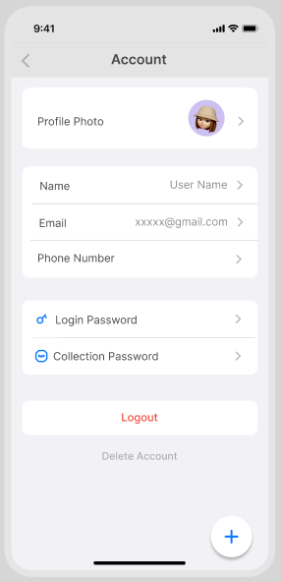
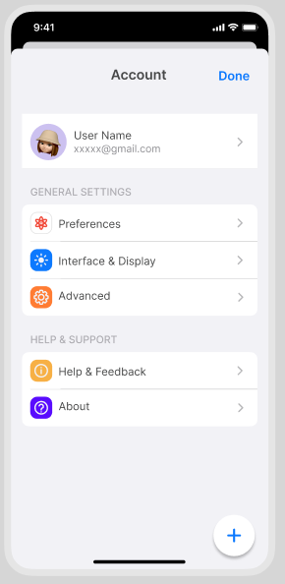
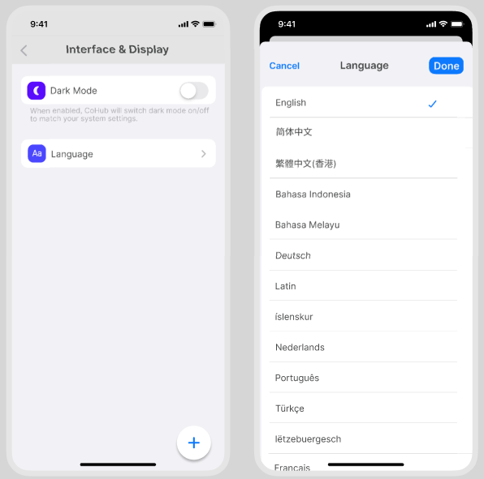
Functional Design
Account management and system settings
8
Notes:
We divided the cohub app into 4 parts.And the 1st one is xxx.
In the account page which is the 1st and 2rd pic, users can login/logout and view their personal info,such as name,email...
For the general settings, users can click the 'interface and display' button to change the dark mode or language.
We also provide channels for feedback.

Slide 10
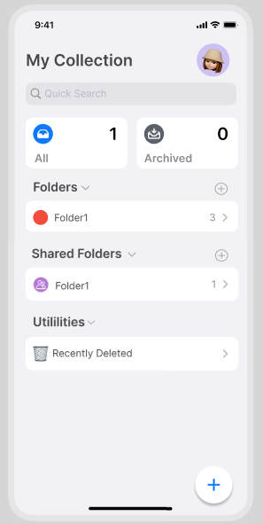
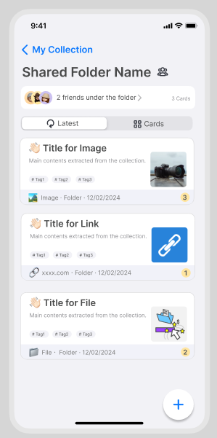
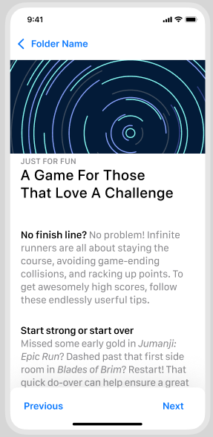
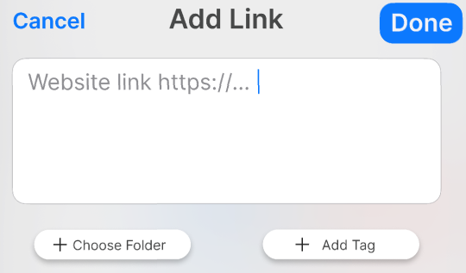
Functional Design
Content Collection
Personal Folder
Shared Folder
Archived Folder
Recently Deleted Folder
9
Notes:
The 2nd part of cohub app is xxx, which is related to 4 kinds of folders.We can see them in the 1st picture.
Shared folder means user can edit the folder with user's friends.Moreover, user and his friend can both add content to the folder.
When user click one folder, he will go into list page which is the 2nd picture.And user can click add button to add new collected card.
On the card details page which is the 3rd pic, users can switch cards by clicking buttons previous and next.

Slide 11
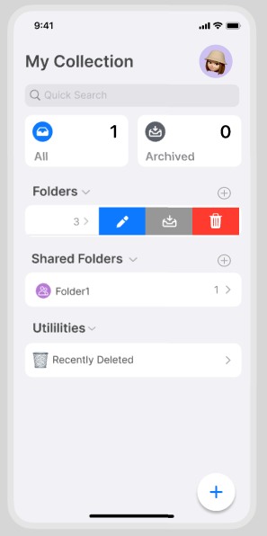
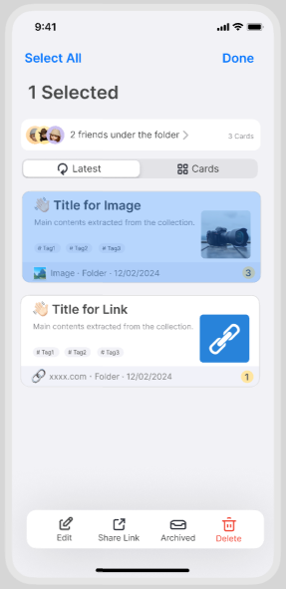
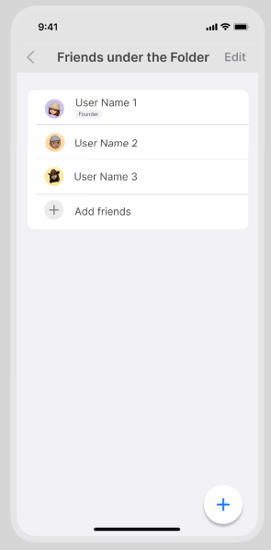


Functional Design
Content Management
1) Personal Folder Management
2) Shared Folder Management
Edit
Share link
Archived
Delete
...
10
Notes:
The 3rd part of cohub is xxx.
For the personal folder and shared folder,users can edit,archive and delete the folder,as shown in the 1st pic.
Once the user enters the folder,he can edit, share link,archived and delete the card as shown in the 2nd pic.
For shared folder, user also can add/delete the friends.

Slide 12
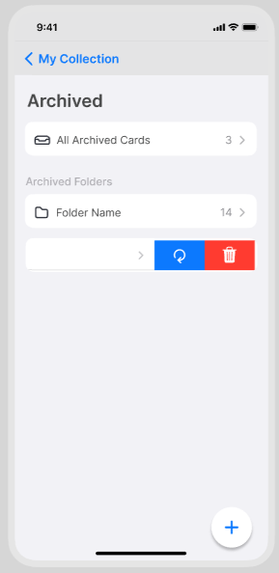
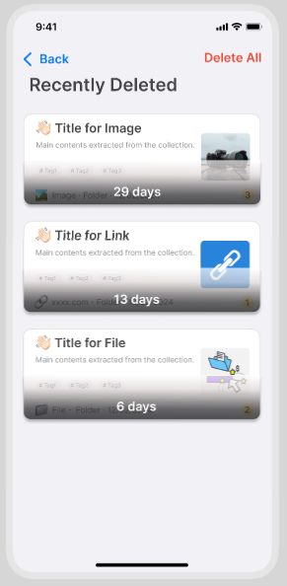
Functional Design
Content Management
3) Archived Folder Management
4) Recently Deleted Folder Management
Recover
Delete
...
The difference between archiving and deleting:
-Archived cards can be edited, viewed, searched, or recovered.
-Deleted cards are temporarily retained for 30 days and can be restored to folders.
11
Notes:
For the archived folder and recently deleted folder,users can recover and delete the folder or cards.
We should pay attention to the difference between archiving and deleting.The archive folder stores completed cards, and the delete folder stores deleted cards.
When we delete the card in the archived folder, this card will be put into the recently deleted folder, but when we delete the card in the recently deleted folder, it will be permanently deleted.

Slide 13

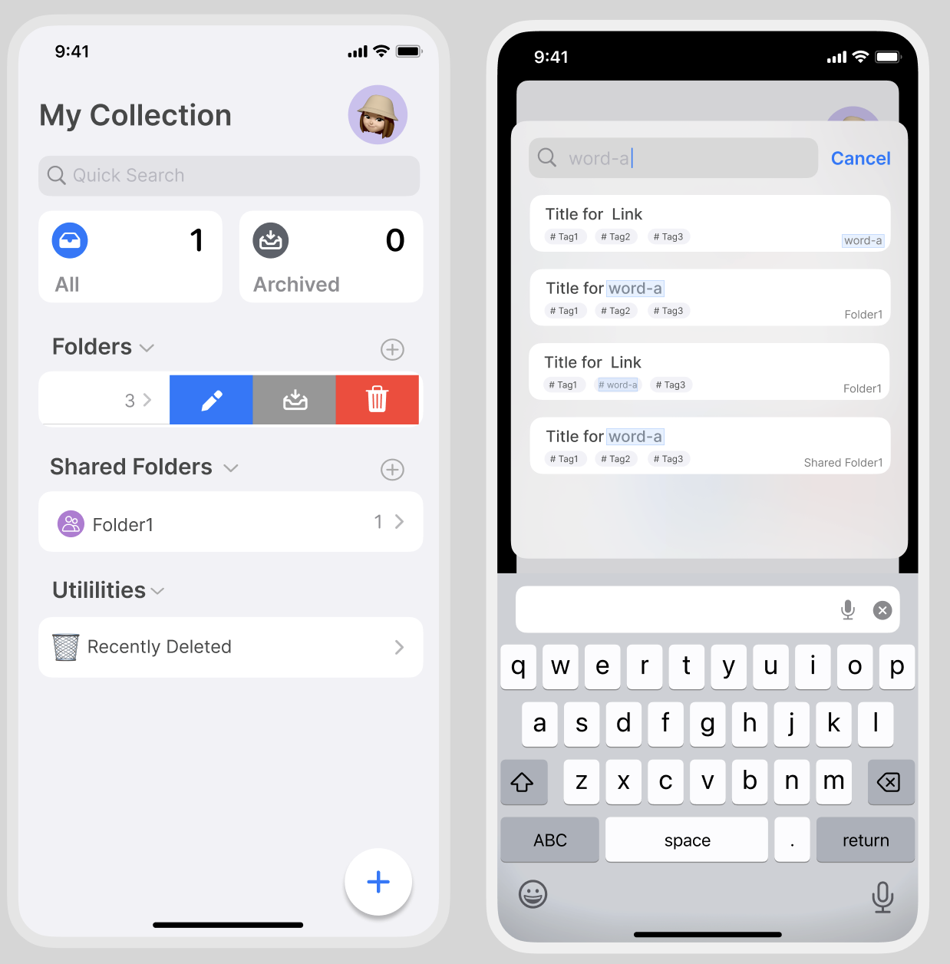
Functional Design
Search Model
Tag Search
Tag Search of Folder
Tag Search of Collected Cards
Folder Search
Personal Folder
Shared Folder
Archived Folder
Recently Deleted Folder
12
Notes:
The 4th part of cohub is xxx.
Every folder and card have a tag and a title.
So search is divided into tag search and folder search.
eg.Users search 'word-a',if a folder's name/tag called 'word-a' or a card's name/tag called 'word-a',users will search them out.

Slide 14
3 Application Development
Notes:
单击此处添加文本

Slide 15
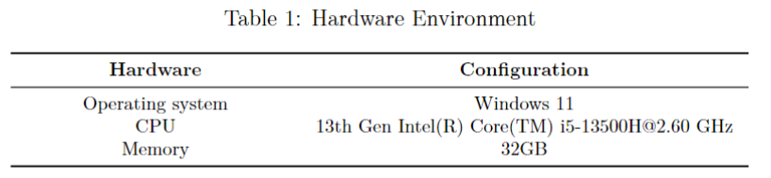
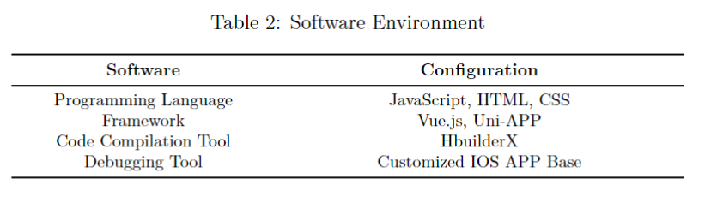
Application Development
Overview of front-end development technologies
Architecture: Front-end and back-end separation
Focus: Mobile devices (Android, IOS)
Technologies: Uni-APP, HBuilderX, Vue.js
14
Notes:
单击此处添加文本

Slide 16
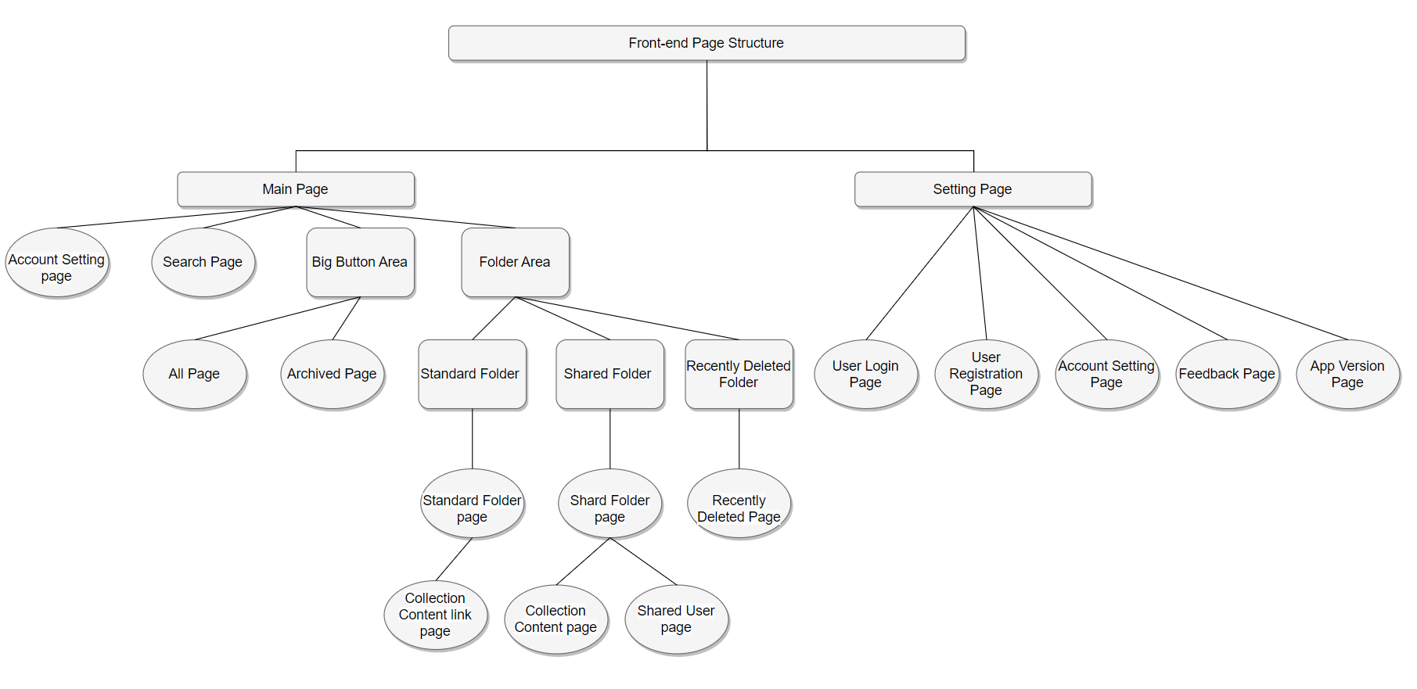
Application Development
The Structure of Page Layout
Main navigation bars: main pages and settings pages
Main page: search, folder area, account settings, collection content, etc.
Settings page: account and app settings.
Figure: The Structure of Page Layout
15
Notes:
单击此处添加文本

Slide 17
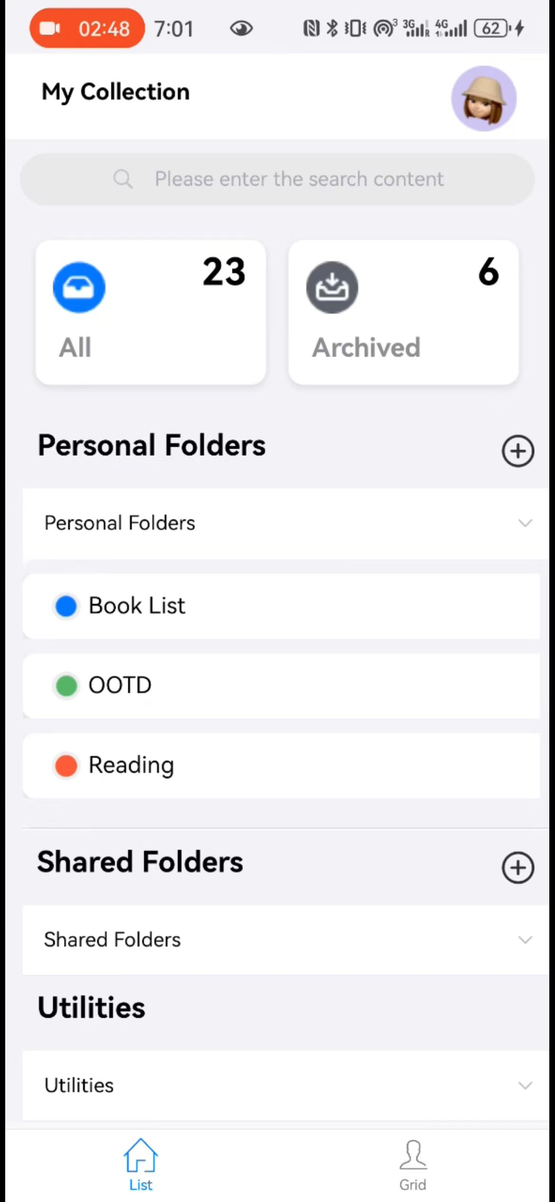
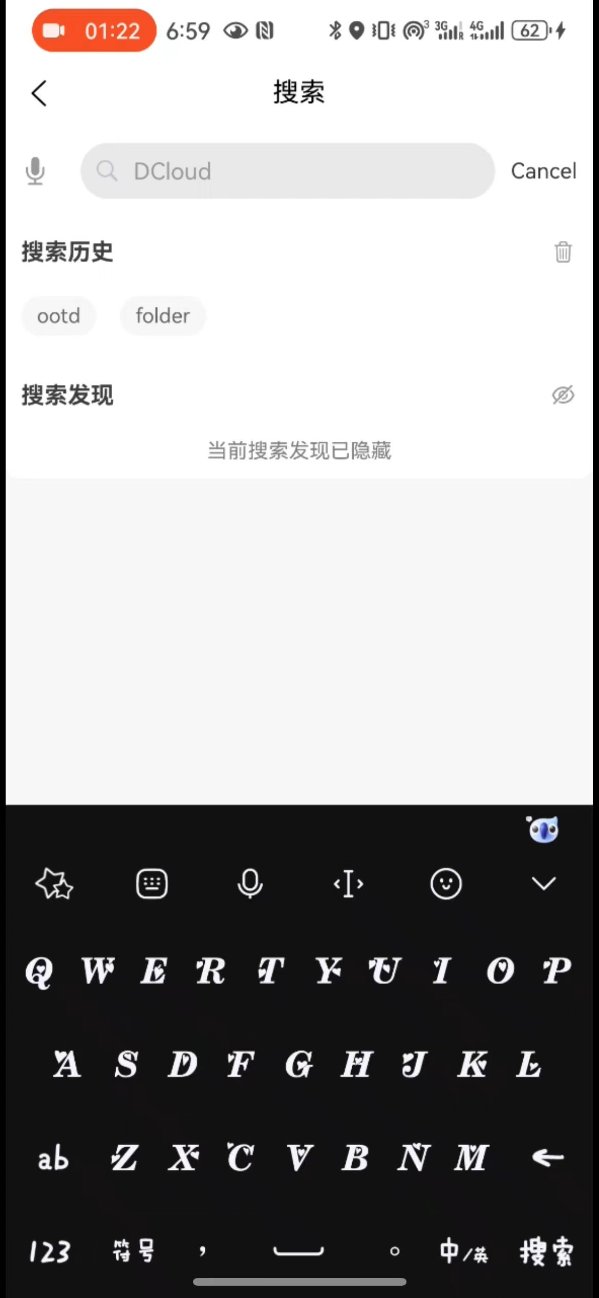
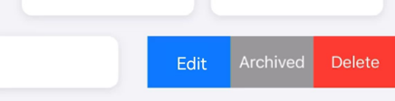
Application Development
Main Page Overview
Search bar
Navigation buttons
All / Archived information button
Count of collected/archived items
Folder area
Personal / Shared / Deleted Folder
Folder item interactions: clicking / swiping
Figure: Main Page
16
Notes:
单击此处添加文本

Slide 18
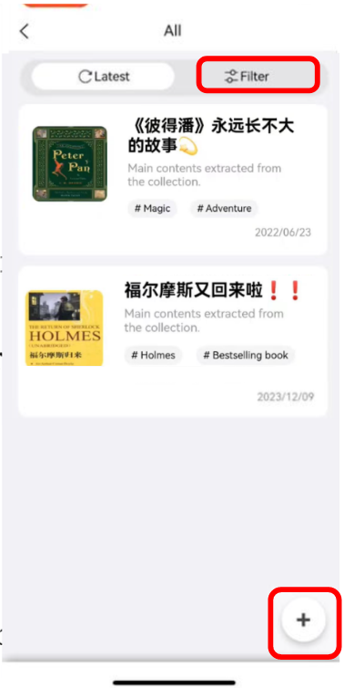
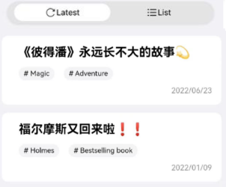
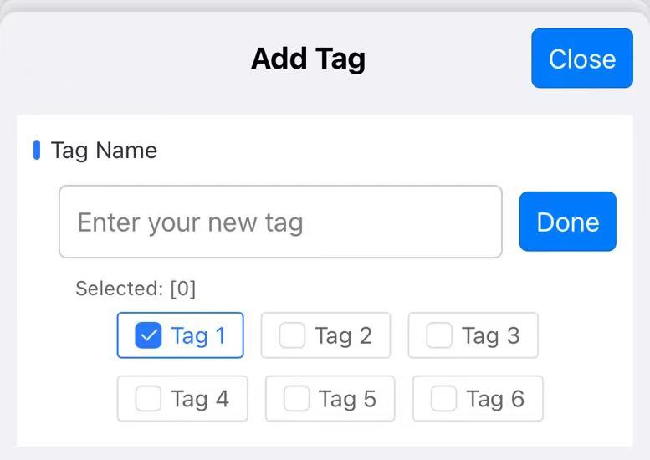
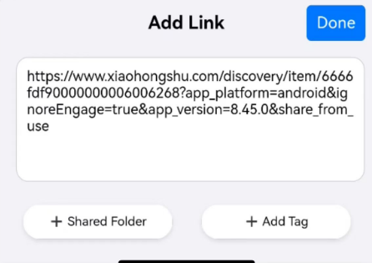
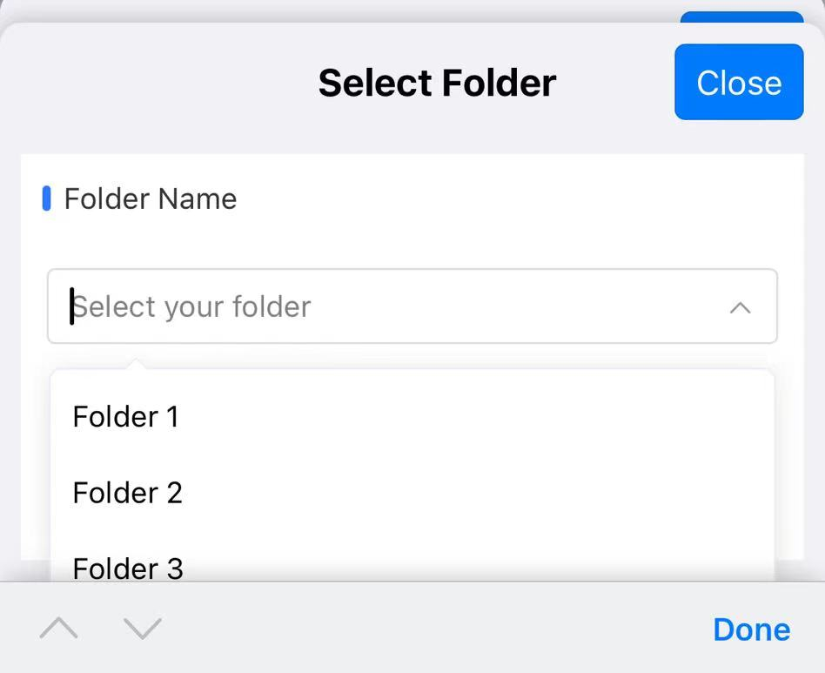
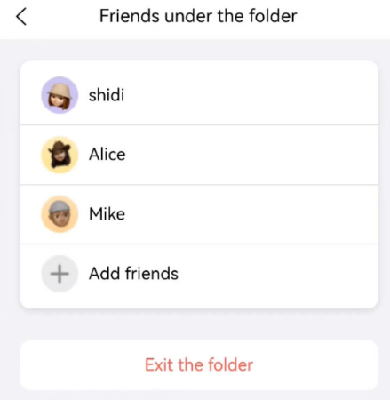
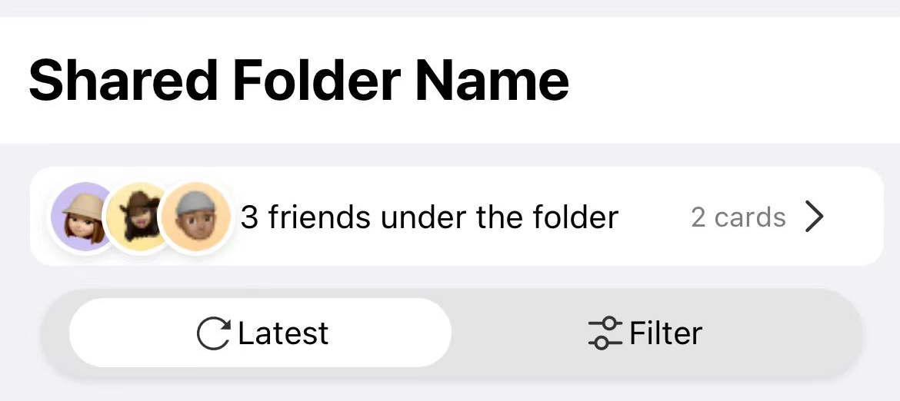
Application Development
Content Collection Page
Personal Folder:
Displayed Type: Cards
Elements: content, description, label, date, etc.
Sorting options:
chronological/reverse order
simple mode
Add the collection content
Figure: Personal Folder
Shared Folder:
Additional shared user bar
Figure: Shared Folder
17
Notes:
单击此处添加文本

Slide 19
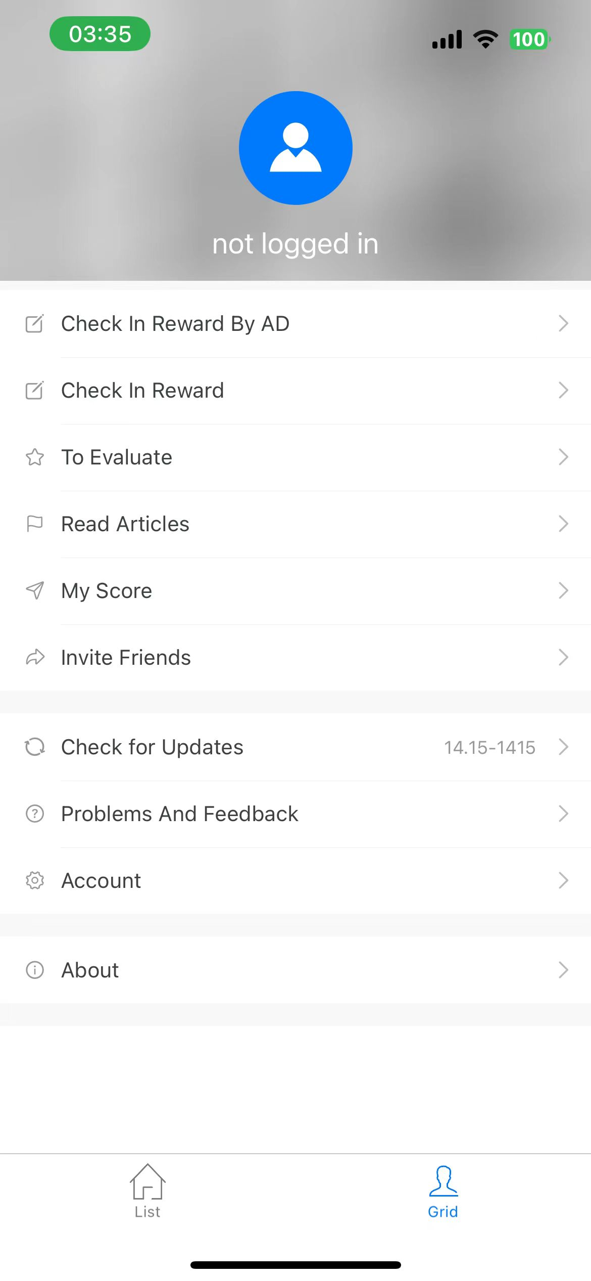
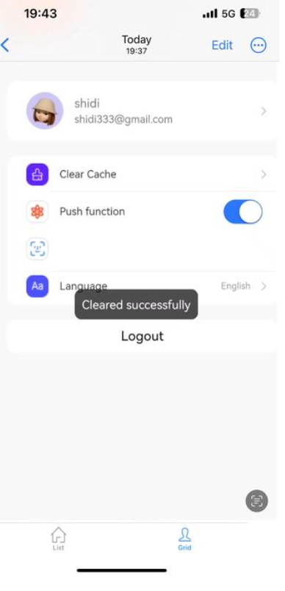
Application Development
Setting Page
User management: personal information and account settings
Features developed:
Account login
Language settings
App Introduction page
…
Figure: Setting Page
18
Notes:
单击此处添加文本

Slide 20
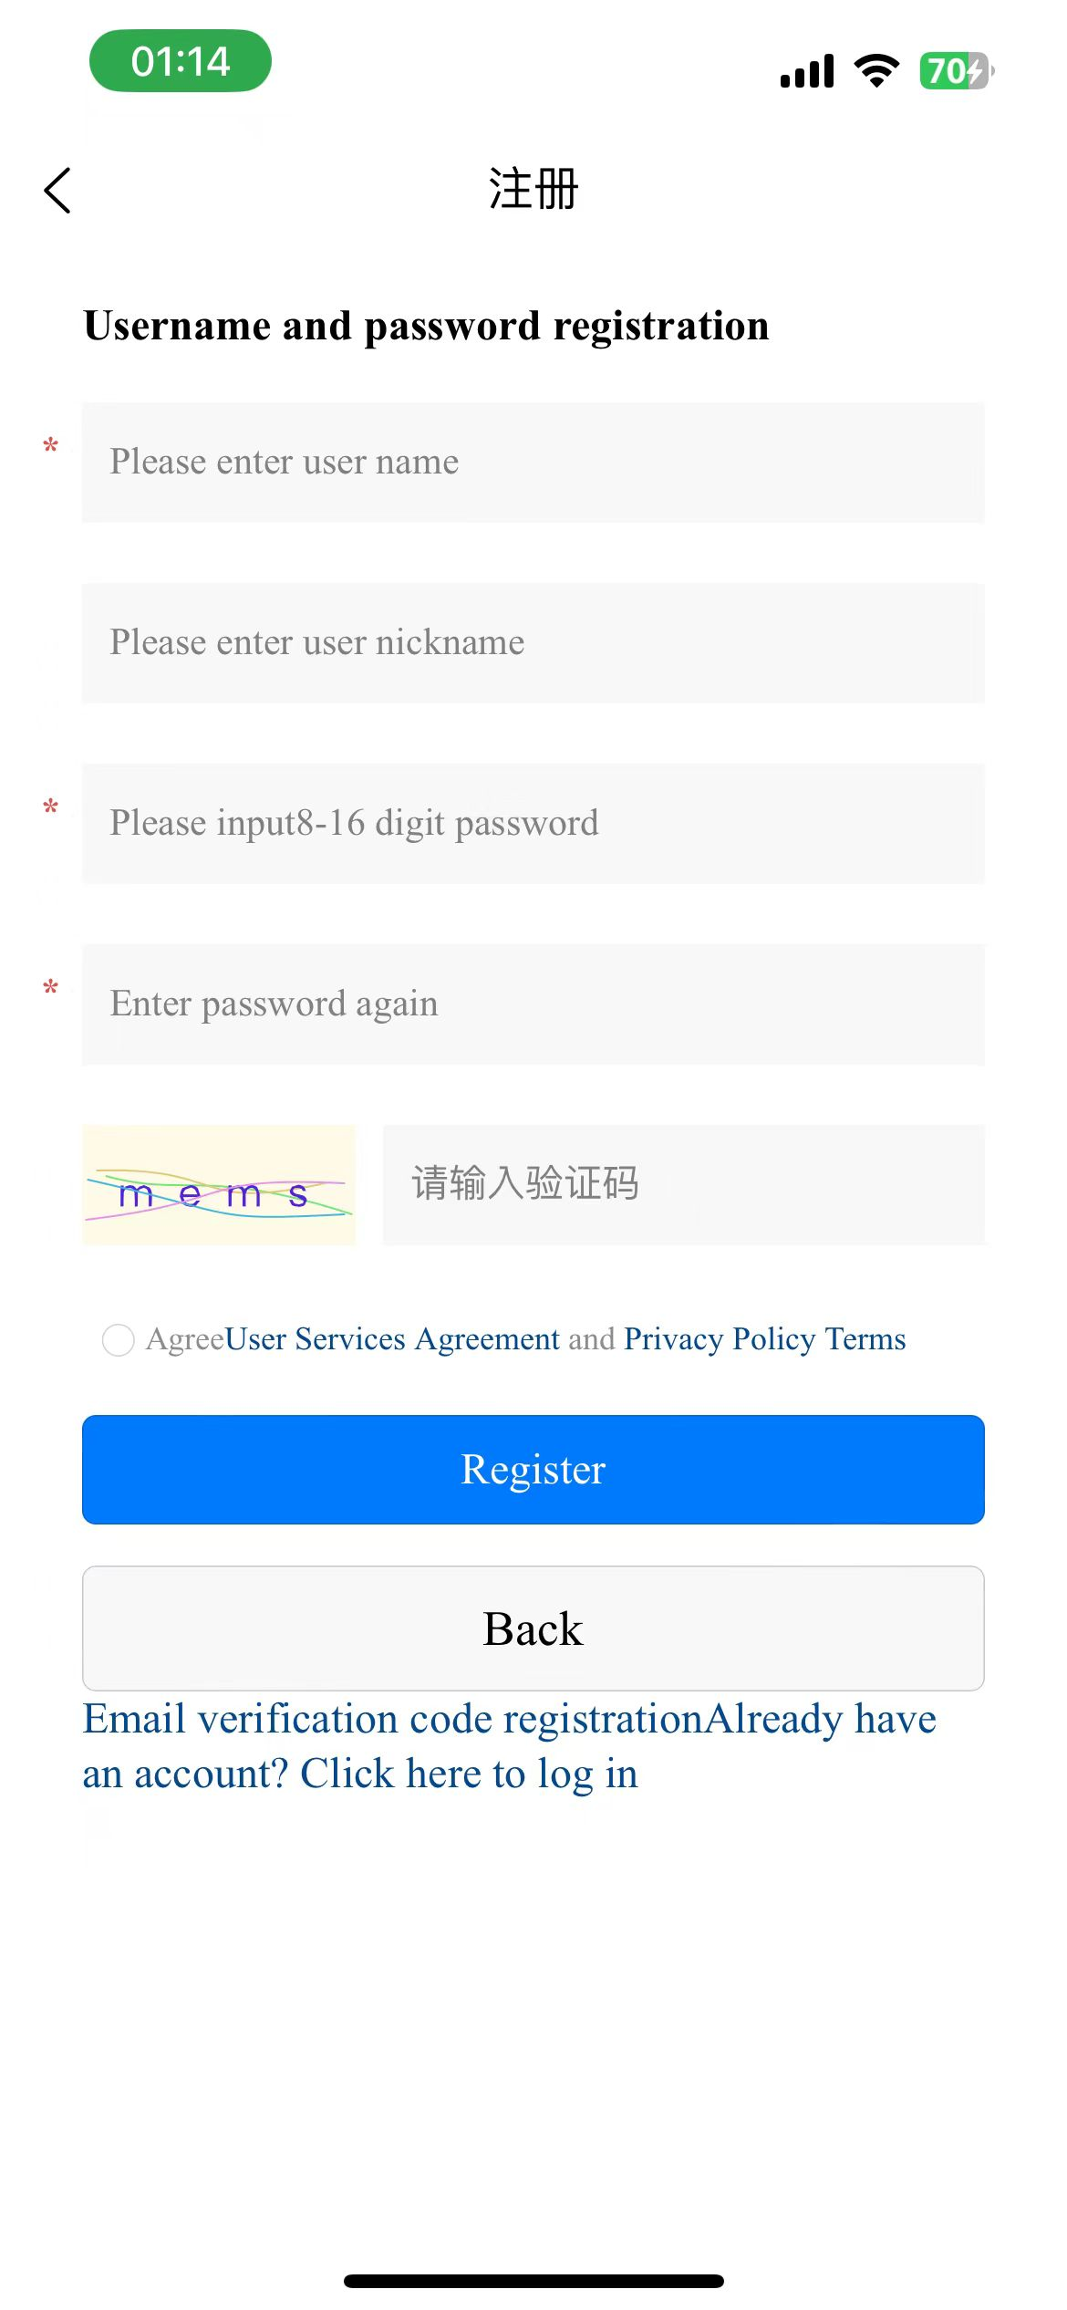
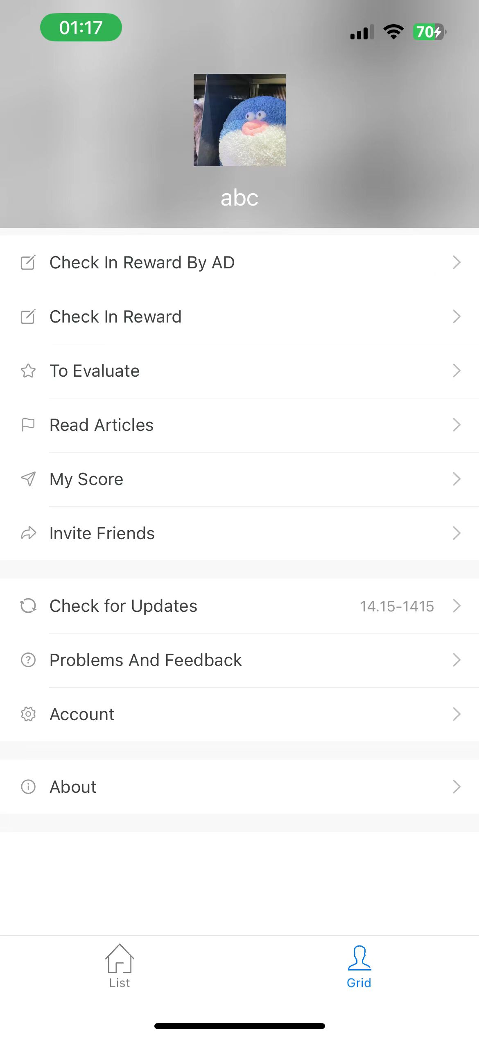
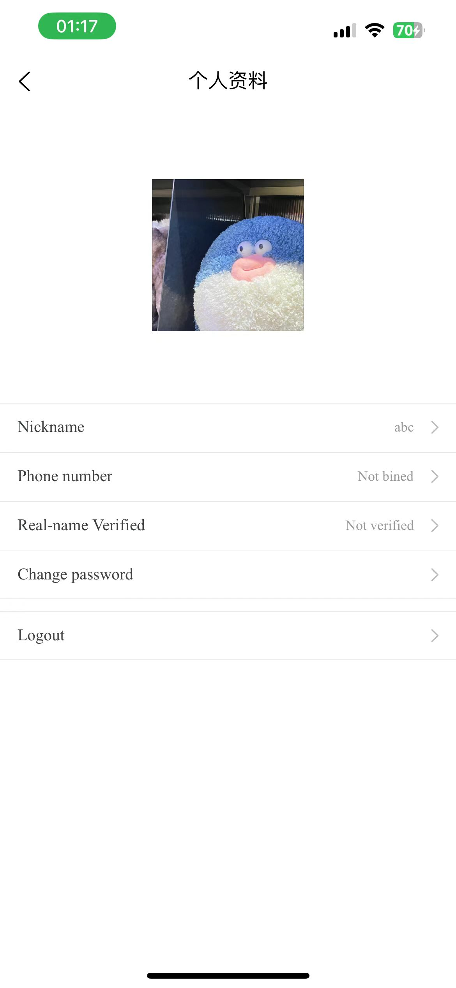
Application Development
Account Registration
Account registration:
Name
Password
Verification code
Information change after registration:
Avatar
Nickname
Mobile number binding
Figure: Account Registration Page
19
Notes:
单击此处添加文本

Slide 21
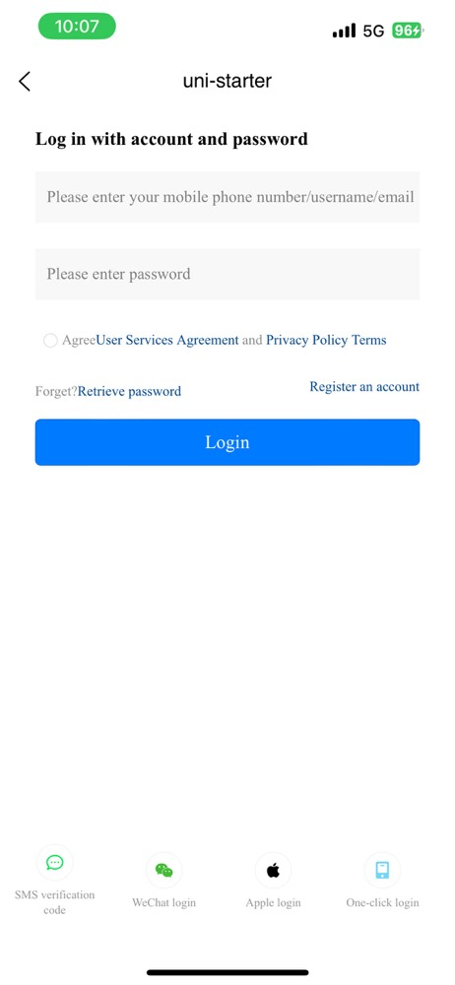
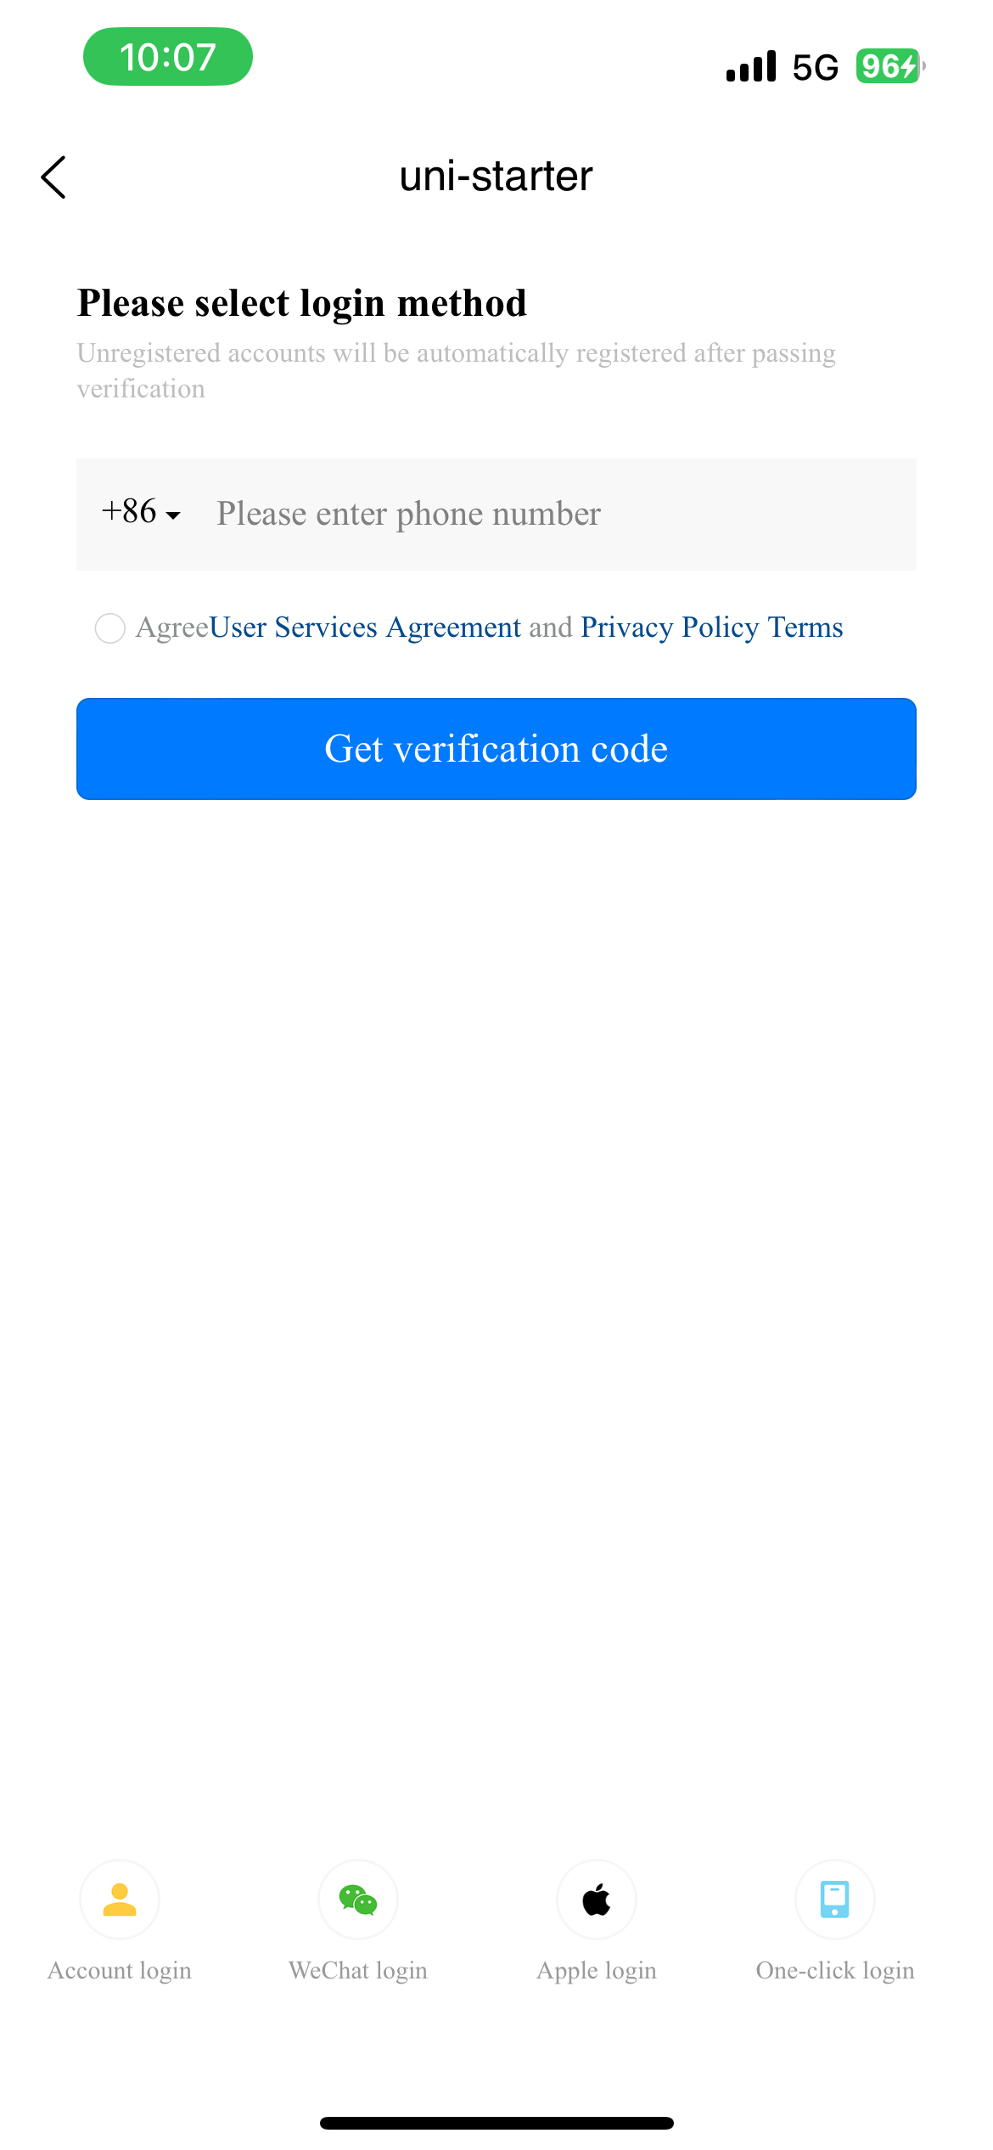
Application Development
Account Login
Account Login Methods:
Account Password Login
Password-free Login (SMS, WeChat, Apple login, etc.)
Authentication: Uses third-party application Token authentication
Figure: Account Password Login | Password-free Login
20
Notes:
单击此处添加文本

Slide 22
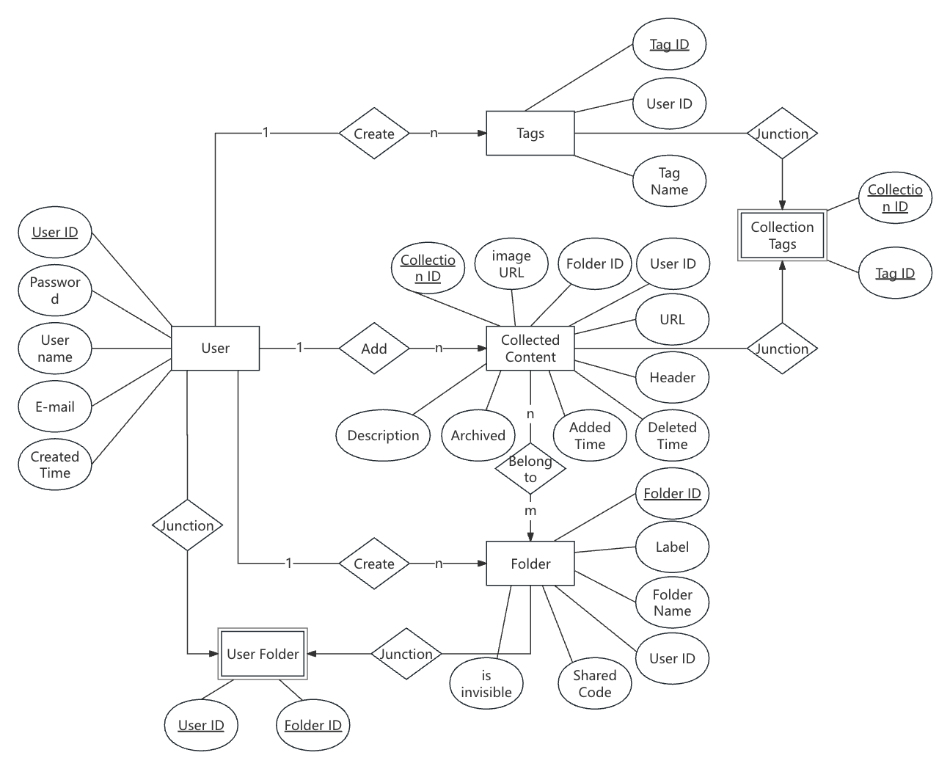
Application Development
Database Design and Construction
Single Table Design: In terms of database form design, a single table design was chosen. Put all users' data of the same type in the same form. This design approach has the characteristics of strong flexibility, easy maintenance, and high query efficiency
Association Table: Using association tables to reflect the many to many relationship between two entities can make database operations easier and more conducive to database maintenance.
E-R Diagram: The E-R diagram is shown on the left.
21
Notes:
First of all cohub as an information management system, reliable and easy to maintain database is the key to ensure that the system can function properly.
In terms of Database design, some of the most important design principles and design tools are Single Table Design, Association Tables, and the E-R Diagram.
First, Cohub uses a single table to manage similar user data, simplifying maintenance and improving query efficiency. Second, it utilizes association tables to handle many-to-many relationships and simplify database operations. On the design side, we draw E-R diagrams to show entities and their associations to guide database development. These design principles make the database powerful, flexible, and efficient, supporting the current functionality and future expansion of the application.

Slide 23
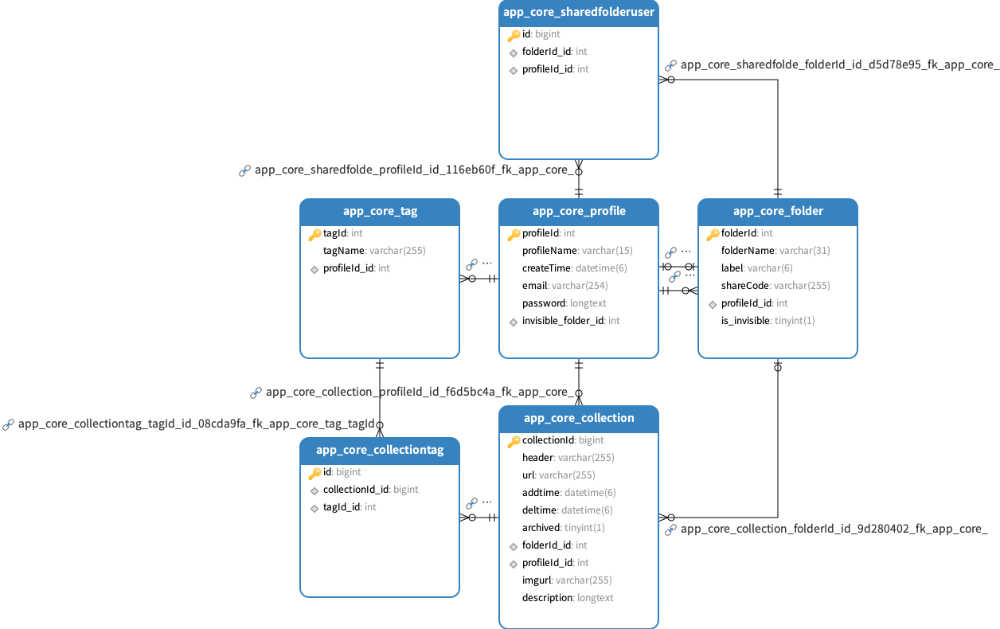
Application Development
22
Notes:
Based on the E-R diagram, we constructed a database. The bussiness-related data table and fields are shown in the figure. The connections between tables reflect the foreign key constraints of the database, ensuring the integrity of the referenced data and achieving cascading updates through this constraint relationship.
For the specific database management tool, we chose MySQL, which is known for its excellent performance and stability in handling large-scale data and highly concurrent access. MySQL supports running on multiple operating systems. It is very suitable for our application scenario.

Slide 24
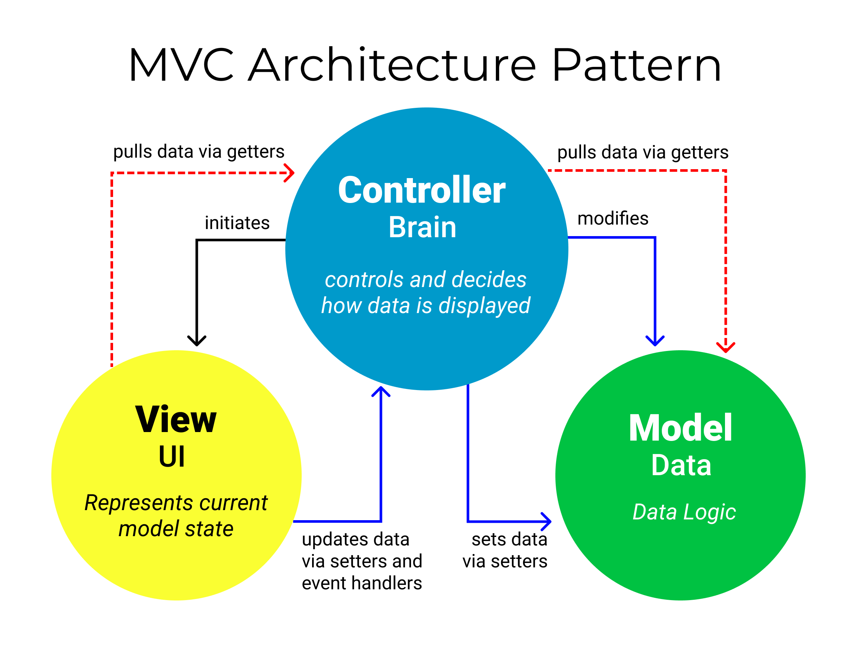
Application Development
Back-end Technology
Django Frame: Django is an advanced Python web framework that follows the MVC design pattern to support the rapid development and maintenance of complex data-driven websites.CoHub uses its built-in ORM, middleware support, and other features to implement back-end services.
RESTful API: The HTTP protocol-based web service design approach designs interfaces that follow the Representational State Transfer (REST) principles. The communication between the front and back end is realized by transferring JSON.
Interface Test: Test cases were designed using Apifox and interface test was completed to ensure that each function Api responded properly.
23
Notes:
The core of our backend technology is the Django framework. Django's MVC architecture, combined with its powerful ORM and middleware, streamlines our backend services. We've used RESTful API principles for our web services, ensuring efficient, stateless communication between the client and server through JSON. We use HTTP methods such as GET, POST, PUT, DELETE, and so on to initiate requests and manipulate the database on the backend. This way allows the API to handle each request independently, without relying on previous interactions.
To guarantee our API's reliability, we've tested each function using Apifox. The result is a robust, scalable system that simplifies development and maintenance for our application.

Slide 25
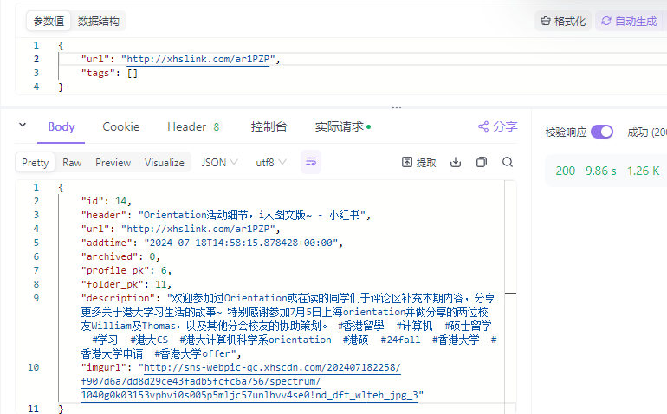
Application Development
Key Technology : URL Link Parsing
BeatifulSoup: BeautifulSoup is a Python library that can be used to parse HTML and XML documents. It creates a parse tree that makes it easy to extract information such as tags, text, attributes, and more. Here are the basic steps on how to extract information from a web page using the BeautifulSoup library:
Valuable Information Extraction: Cohub extracts valuable, renderable information from web pages through the BeautifulSoup library. For example, the page title, main content and image links. This can be displayed in the front-end.
24
Notes:
In addition to adding, deleting, querying and updating databases, one of the core functions of CoHub is to parse the content of web pages through the URLs entered by the user before it can be rendered on the front-end. For the implementation, we use the beautifulsoup package to parse the HTML file of the web page and extract the element tags we need from it. We focused on supporting the content of the Little Red Book platform. The figure shows the URL of a note content post by the Department of Computer Science of the University of Hong Kong on Little Red Book and the content of the extracted JSON file.

Slide 26
4 Algorithm Implementation
Notes:
Thank you Xingnuo for introducing the part of backend implementation. Now let's focus on the algorithm.

Slide 27
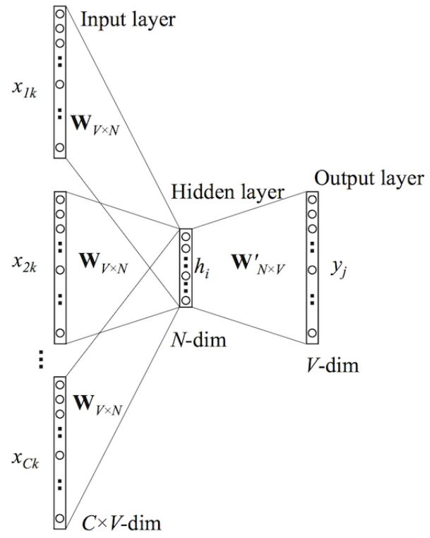
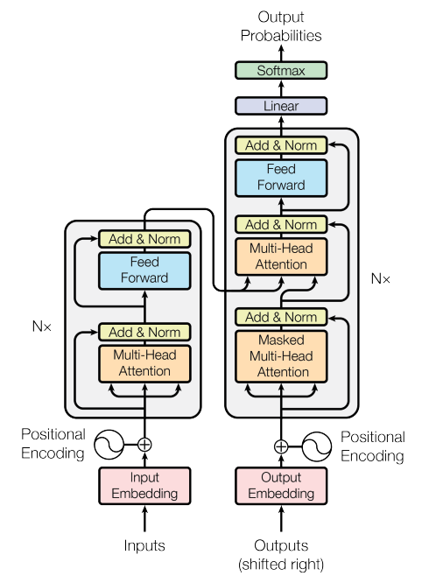
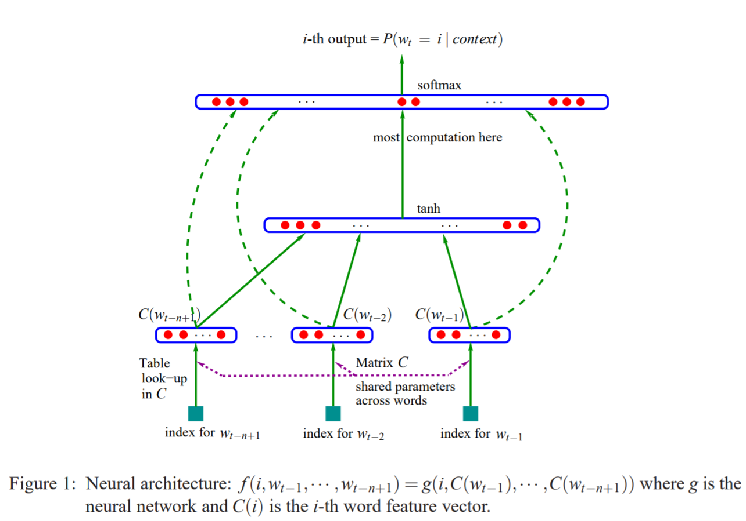
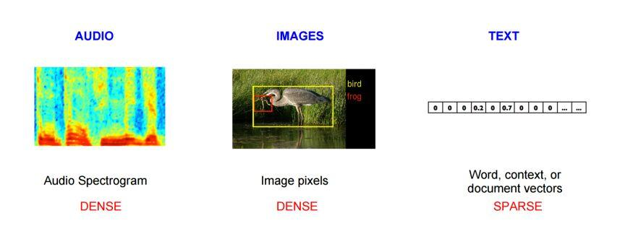
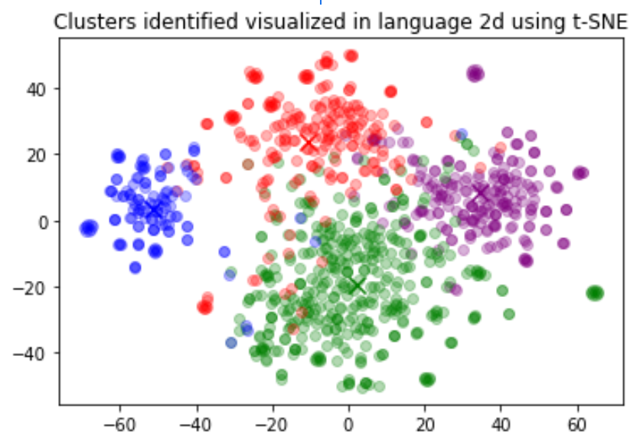
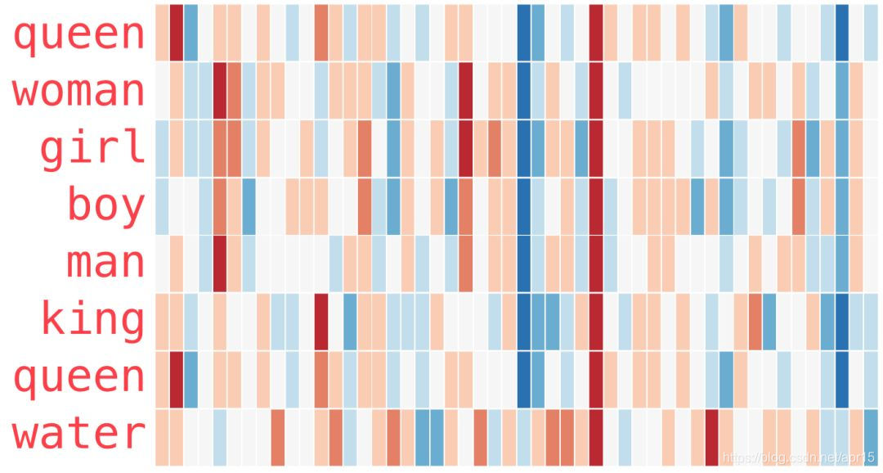
Algorithm Implementation
26
Notes:
From the earliest Natural Neural Language Model, to Continuous Bag of Words, to the sota work Transformer, the architecture of the language model is always changing, and the semantic understanding module is improving also. However, there is one thing that hasn't changed. From one-hot encoding to word2vec to embeddings, engineers have been working to transform text into more semantic vectors.

Slide 28
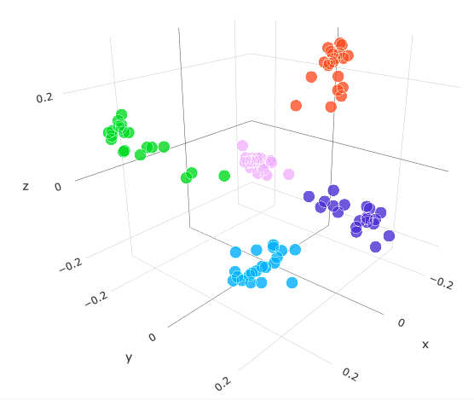
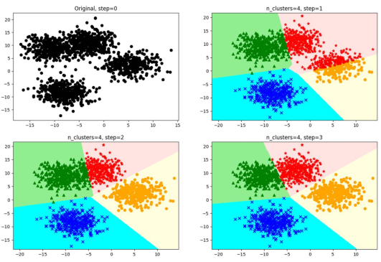
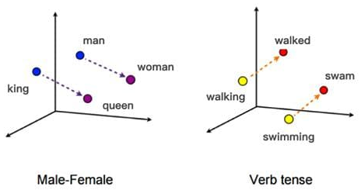
Algorithm Implementation
Problem: Tags are defined by users
Solution: Unsupervised Learning
Reasons:
Incomplete tag for all collections: Impratical for superviced learning
Effectiveness of Embeddings: Semantic level classification
Applicability of K-means Clustering: K-means is a widely used clustering algorithm that partitions data into K clusters while data points in different clusters are dissimilar.
+
28
Notes:
Let’s bring our perspective closer to the problems we might meet. The problem is that tags are defined by users rather than given by us. This will make the pre-trained model unusable - because one important condition for using a pre-trained model is to know the distribution of tags. To address this issue, we use K-Means, an unsupervised algorithm to build the classifier.

Slide 29
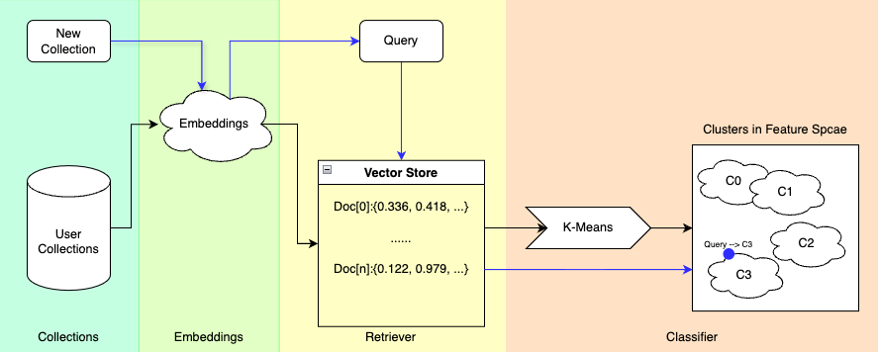
Algorithm Implementation
29
Notes:
Let's move on to the architecture design of our auto-tagger. This figure details how the auto-tagger works. Note that there are two different colors of lines corresponding to two scenarios, the black one means we apply auto-tagger for all the collections of one user with his given pre-set tags, while the blue one means when a user creates a new collection, how the system recommends a tag for it.
As the scenario is determined, the related data will be embedded by the cloud embeddings and stored in the vector store, or forming a query for the subsequent stage. When applying classification task for all collections, with the user's self-defined tags as the initial centroids, we use the K-Means to group the collections into clusters. For the tag recommendation, we calculate the distance from each cluster to the query and select the shortest one as the major recommendation result.

Slide 30
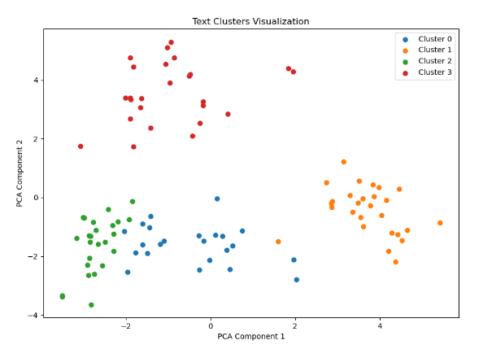
Algorithm Implementation
Embeddings: bge-zh-base-v1.5
Retrieve algorithm:
Cosine Similarity (best)
KV-search (normal)
MMR (unacceptable)
Topic: Sport, Trip, Cuisine, Pet
Accuracy: 95/100
Error only occured on decision boundary
Inherent advantage of K-Means
Good for decentralized centroids
30
Notes:
This figure shows one test case result. We define 4 tags: Sport, Trip, Cuisine and Pet. For each tag, we create 25 different collections with related content.
As the classifier is driven by K-Means, the error only occured on the decision boundary of each topics. This is because the classification criterion of K-Means is highly related to distance. Also, the performance of K-Means is very sensitive to the initial centroid selection, user-defined tags can make up this shortcoming very well, because they know what they have in collections.
Let's finish this part with highlighting the 95% accuracy achieved in this case.

